Slide 1
Date: 25 November 2025

Slide 2




Weekly report: Team Gearbox, Brake, Coupling
Week number : 09
Date: 25/11/2025
Supervisor: Prof. Peter Quell
Group Members :Nehang Jitendra Joshi,Santo Mazumder,Md Razaul Karim Rahat
Presented by -Nehang Jitendra Joshi
25-11-2025
Gearbox, Brake, Coupling

Slide 3
List of Content
1.Calculation of the 1st stage of planetary gear and 2nd stage also Spur gear stage calculation updated
2.Material selection overview
3.Bearing selection overview
4.Displacements on Coupling
25-11-2025
Gearbox, Brake, Coupling

Slide 4
Formulas for Planetary gear
z_Ring | z_Sun +( 2 x z_Planet)
z_Planet | z_Sun - z_Ring / 2
No. of Planets | 5 and 4
D_Sun | z_Sun x Module
D_Planets | (D_Ring /2) – (D_Sun/2)
D_Ring | z_Ring x Module
Gap | (D_Sun + D_Planets) * Pi / (No. of Planets) - D_Planets
Face Width | 10 x Module
Tooth Depth | 2.25 x Module
n_Ring | 0
n_Planet Carrier | 10.12 rpm
n_Sun | (1-i_1) x n_Planet Carrier
i_Sun,Planet | z_Planet / z_Sun
n_Planet | n_Sun / i_Sun,Planet
z = No. of Teeth
n = RPM
D = Pitch Circle Diameter
i = Gear Ratio
Reference: Lecture Notes by Prof. Peter Quell
25-11-2025
Gearbox, Brake, Coupling

Slide 5
1st Stage of planetary
I-1 ratio | 5
D_Planets (mm) | 765
Module mm | 15
z_Sun | 34
z_Ring | 136
z_Planet | 51
No. of Planets | 5
(z_Sun + z_Ring)/No. of Planets | 34
Tooth Depth | 33.75
D_Sun (mm) | 510
D_Ring (mm) | 2040
Gap (mm) | 16.77
Face Width | 150
n_Ring (rpm) | 0
n_Planet Carrier (rpm) | 10.12
n_Sun (rpm) | 40.48
i_Sun,Planet | 1.5
n_Planet (rpm) | 26.98
Reference: Lecture Notes by Prof. Peter Quell and PSGdesign book
25-11-2025
Gearbox, Brake, Coupling

Slide 6
2nd Stage of planetary
I-2 ratio | 4.9
D_Planets (mm) | 660
Module mm | 12
z_Sun | 37
z_Ring | 147
z_Planet | 55
No. of Planets | 4
(z_Sun + z_Ring)/No. of Planets | 46
Tooth Depth | 27
D_Sun (mm) | 444
D_Ring (mm) | 1764
Gap (mm) | 6.73
Face Width | 120
n_Ring (rpm) | 0
n_Planet Carrier (rpm) | 40.48
n_Sun (rpm) | 473.61
i_Sun,Planet | 1.48
n_Planet (rpm) | 106.66
Reference: Lecture Notes by Prof. Peter Quell and PSGdesign book
25-11-2025
Gearbox, Brake, Coupling

Slide 7
Spur gear stage
I-3 ratio | 4.9
Module mm | 14
Center distance mm | 602
No of teeth on pinion | 108
No.teeth on gear | 22
Width of the gear mm | 140
Hight factor mm | 1
Tooth depth mm | 31.5
Bottom clearance | 2.25
Dia of input shaft mm | 100
Dia of output shaft mm | 185
PCD of pinion | 1512
PCD of gear | 308
Face width | 140
Input shaft rpm | 473.61
Output shaft rpm | 1200
Reference: Lecture Notes by Prof. Peter Quell and PSGdesign book
25-11-2025
Gearbox, Brake, Coupling

Slide 8
Material selection overview
No | Components | Material
1 | Gearbox housing | Cast iron (GJS 400-18-LT)
2 | Gears | 18CrNiMo 7-6 grade steel
3 | Coupling | Cast iron (GJS 400-18-LT)
4 | Brake | Cast iron (GJS 400-18-LT)
25-11-2025
Gearbox, Brake, Coupling

Slide 9
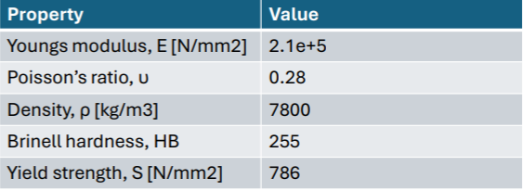
Gears Material Specification
Reference: Lucefin website and Optimus shakti
25-11-2025
Gearbox, Brake, Coupling

Slide 10
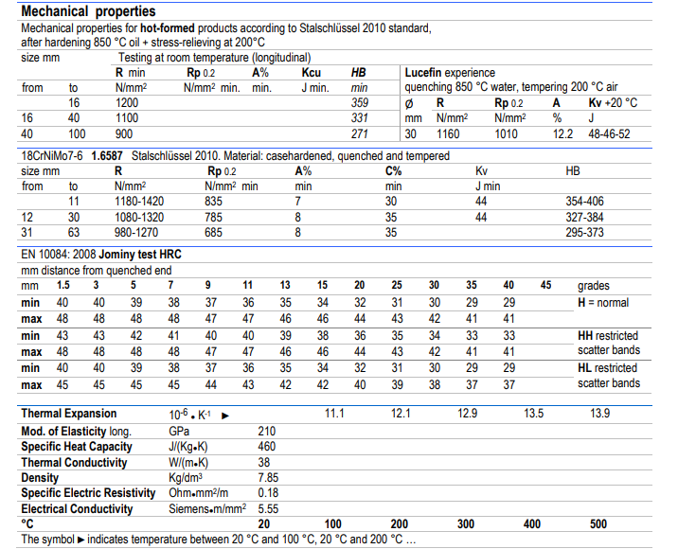
Gears Material Specification
Reference: Lucefin website
25-11-2025
Gearbox, Brake, Coupling

Slide 11
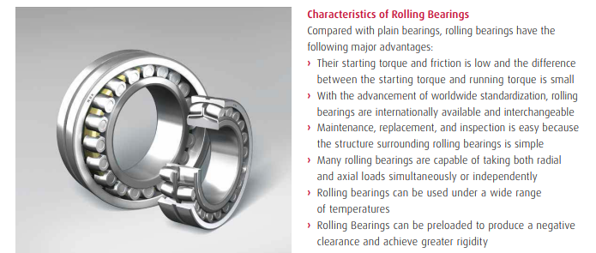
Bearing selection overview
coroll.cz website
25-11-2025
Gearbox, Brake, Coupling

Slide 12
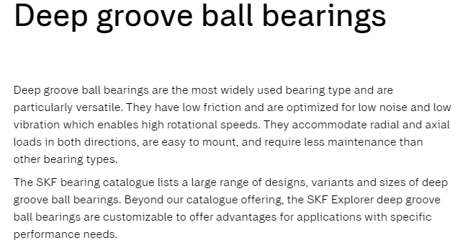
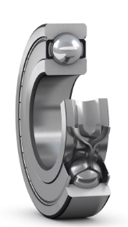
Bearing selection overview
SKF website
25-11-2025
Gearbox, Brake, Coupling

Slide 13
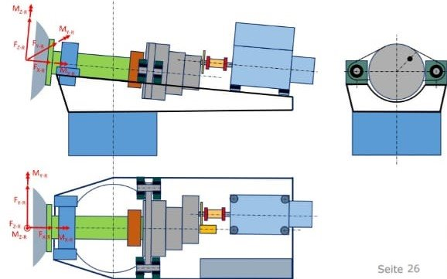
Displacements on Coupling
For the high-speed shaft all radial, axial and angular displacements between
Gearbox and Generator.
Front Rotor Bearing.
Compensation of displacement by:
Movement between gearbox and generator
Elastic deformation
Production tolerances
Thermal expansion
Bearing clearance
Source: Quell, P.: Lecture note ‚Machinery Components
25-11-2025
Gearbox, Brake, Coupling

Slide 14
Bibliography
Gearbox
(1) Previous year Optimus projects(60E,92LE,Shakti 21-11-2025
(2) Roloff Matek Maschinenelemente 21-11-2025
(3) Lecture notes – Mechanical drive train by Prof.Peter Quell.22-11-2025
(4)Shigley's mechanical engineering design and PSG data book 20-11-2025
(5)Lucefin website 22-11-2025
(6)Bearing-coroll.cz and SKF website 22-11-2025
Coupling
(1)Lecture notes-Machinery Components by Prof.Peter Quell 21-11-2025
25-11-2025
Gearbox, Brake, Coupling

